Slide 1

W210
Presentation #1
BERTVision
Improving performance on a wide range of Natural Language Processing tasks using parameter-efficient model architectures training on BERT’s hidden state activations
Siduo Stone Jiang and William Casey King and Andrew Fogarty and Cristopher Benge

Slide 2

Impact &
Feasibility
Transformer models are powerful, but have a high parameter count and computational footprint.
Other compression techniques prune parameters or reduce numeric precision, but at a cost.
SOTA progress in NLP with transformers is on a collision course with absurdity (1T+ parameters).
Our current method still requires minor fine-tuning of BERT, but we’re evaluating transfer learning with the smaller models in this project.
If our solution ultimately requires BERT weights, we could offer inferencing as-a-service through REST API.

Slide 3
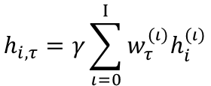
BERT_{LARGE}
TRAIN Embeddings (131911, 386, 1024, 25)
Transformer Block₂₄
Learned Pooling Weights (26,)
Embeddings Generated (N, 386, 1024, 25)
Pooled Embeddings (N,386,1024)
Transformer Block₃
Transformer Block₂
Dense(2,386)
Transformer Block₁
$$h_{i,τ}=γ\sum_{ι=0}^{Ι}{w_{τ}^{(ι)}h_{i}^{(ι)}}$$
Input embedding : | (N, 386, 1024, 1)
Layer 1-24 output[0] token : | (N, 386, 1024, 24)
Span Start
input embeddings
DEV Embeddings (12227, 386, 1024, 25)
Span End
Inspired by Tenney et al. 2019

Slide 4

Preliminary Work
SQuAD 2.0
Cloud Infrastructure
GLUE Benchmark
BERT-Large and BERTVision on Q&A and binary classification
GPUs and VMs and Azure, oh my!
BERT-base benchmarks against all GLUE NLP tasks
We have a robust pipeline of work completed to-date, including most of our infrastructure needs, a preliminary paper in Overleaf from our results in W266 against SQuAD 2.0, and up-to-date benchmark data on all GLUE NLP tasks for the BERT-base (110M parameter) transformer model

Slide 5
















BERTVision Development Pipeline
SQuAD v2.0 +
GLUE Benchmark
DEVELOPMENT
TRAINING INFRASTRUCTURE
Notebook
Atom
VS Code
Azure Data Science VM
STORAGE
DATA PROCESSING
Azure Data Science VM
BERT Vision Repo
HDF5
(processed dev)
HDF5
(processed train)
Python
Torch v1.7.1 & Transformers & TensorFlow 2.4
RAW
(JSON/TSV)
DATA VISUALIZATION
DOCUMENTATION
Home-based Deep Learning Machine (bare-metal)
Plotly
Azure Boards

Slide 6
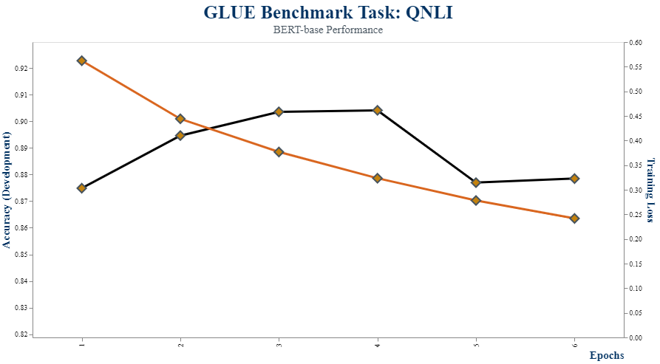
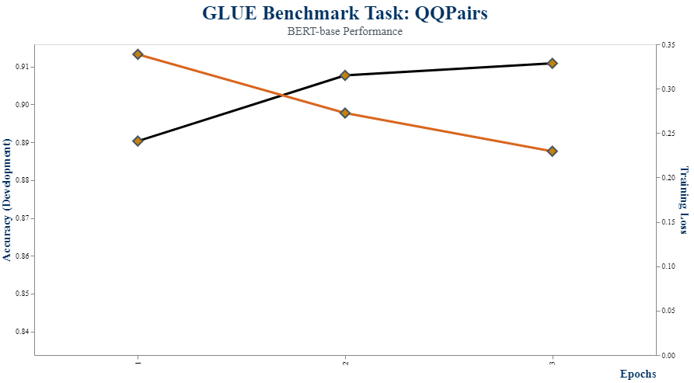
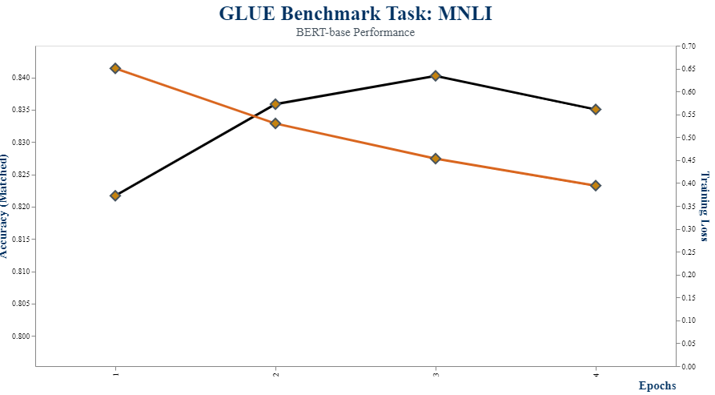
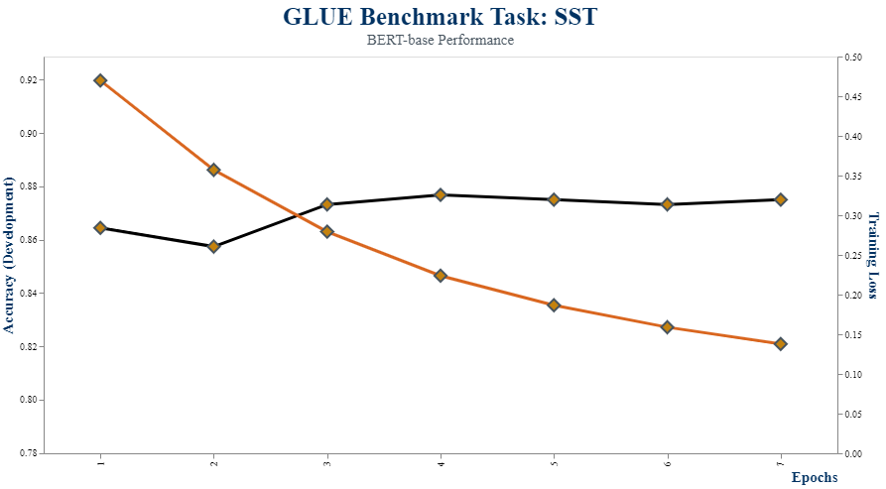
BERTVision GLUE Benchmarks*
*BERT-base performance

Slide 7
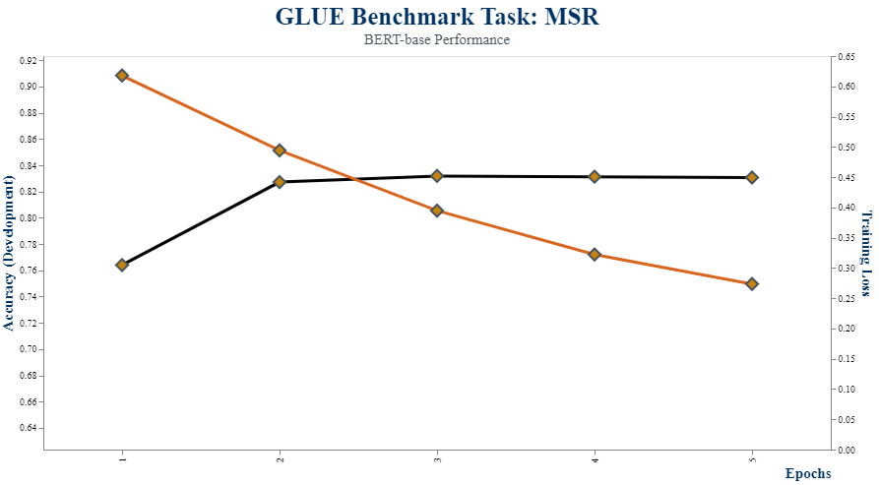
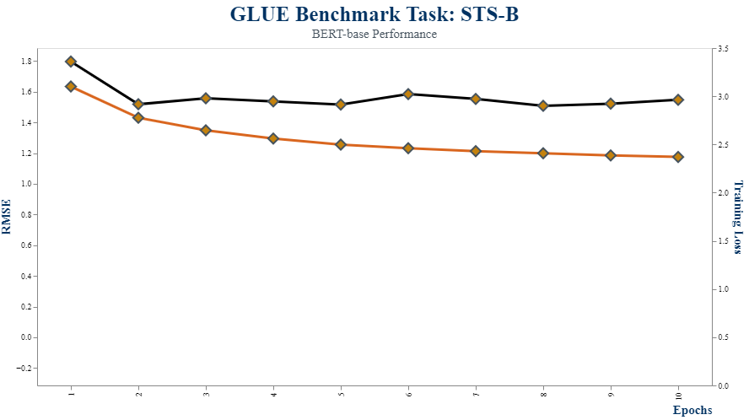
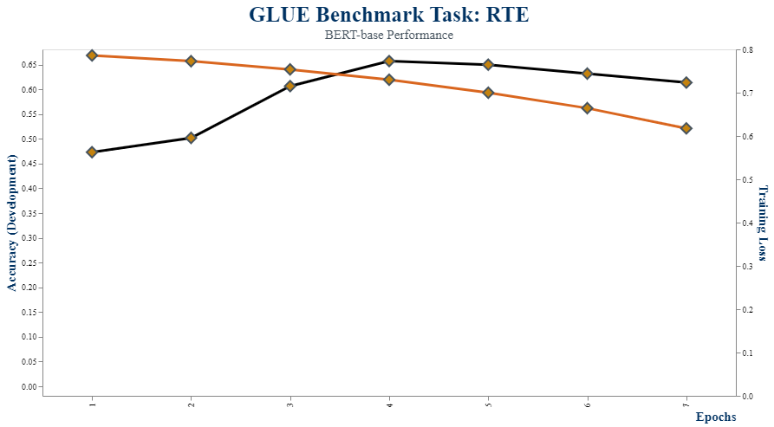
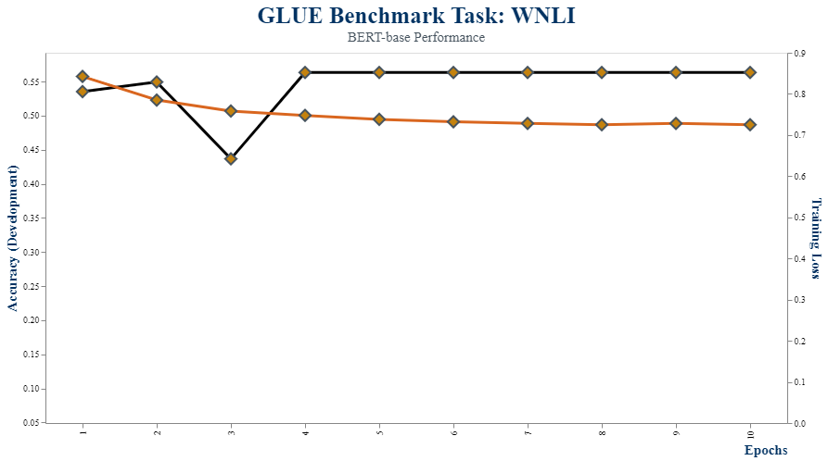

Slide 8
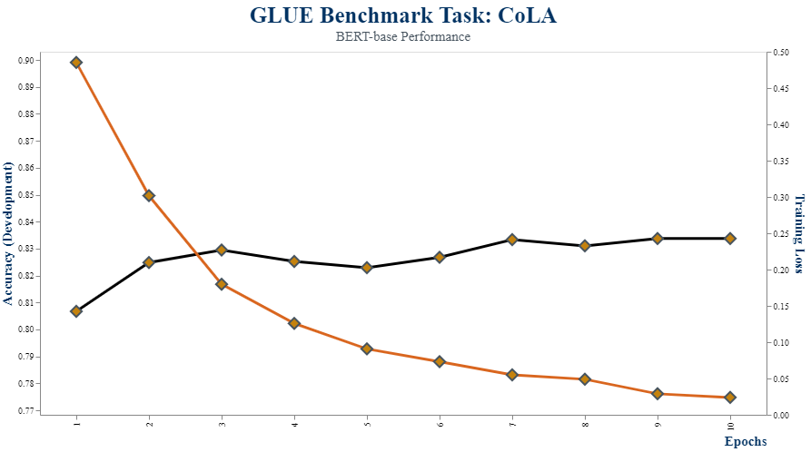
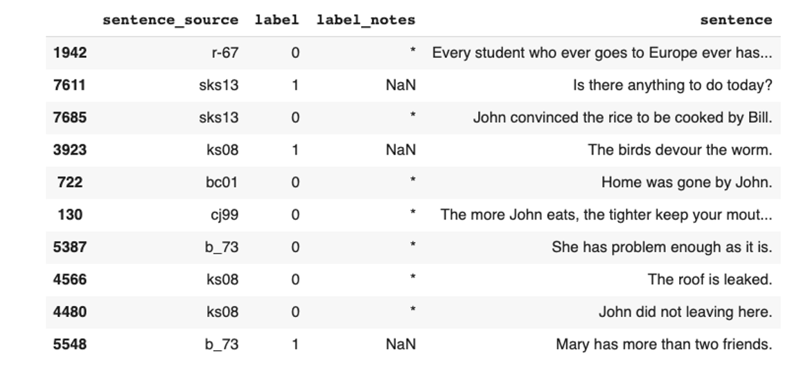
The Corus of Linguistic Acceptability is a collection of 10,657 sentences from 23 linguistics publications, expertly annotated for acceptability (grammaticality) by their original authors. The challenge is to predict a binary classification for each sentence, identifying those that are grammatically correct (TRUE) and those that are not grammatically correct (FALSE).

Slide 9

Semester
Plan
We have essentially 9 weeks to complete baseline of dozens of large (340M+ parameter) models, evaluate transfer learning tasks between datasets and between task categories for BERTVision models, interpret results, and publish a high-quality paper aimed at the EMNLP 2021 conference [held in the sunny Dominican Republic on November 7th – 11th].
“The future is uncertain, and the end is always near.” – Jim Morrison, Roadhouse Blues (1970)
Our aim is to test a novel idea; the future of which is uncertain. if transfer learning is not as successful as we hope, we will need to shift focus to the value of extending BERT performance cheaply with our already demonstrated technique of embedding extraction and linear learning.

Slide 10
Remaining Research
02
04
Baseline BERTVision
Iterate on Model Design
Baseline the current architecture of BERTVision against GLUE
Evaluate other approaches beyond our current adapter-linear design
01
05
Baseline BERT-large
03
Publish
Transfer Learning
Capture BERT-large baseline performance against GLUE tasks
Work with Alberto, Puya, and Daniel to author a journal quality paper (targeting EMNLP 2021)
Evaluate BERTVision mini-models on transfer learning tasks

Slide 11

Success
Evaluation
Success will depend greatly on our ability to live up to the vision of the project: to provide a novel approach to NLP tasks that requires a fraction of BERT’s computation cost and time by learning from the dormant hidden state activations within.
BERTVision Models
91%
BERT-Large Models
71%
* A fictionalized representation of our goal: to beat BERT-large across a spectrum of NLP tasks at a fraction of the size and cost.

Slide 12
Metrics for Success
BERT v BERTVision
Think Small
Reduced Time
Academic Contribution
We will evaluate our models with BERT-large for the NLP tasks
Our success depends on shrinking the footprint of BERT
Time to fine-tune and get results is a critical part of our value
Contribute to the NLP research community? Check!

Slide 13
THANKS
Questions?

